Slide 1
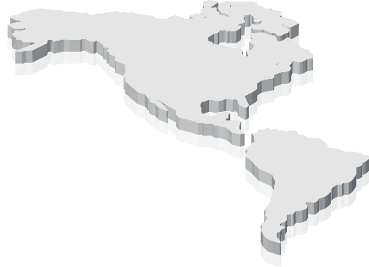
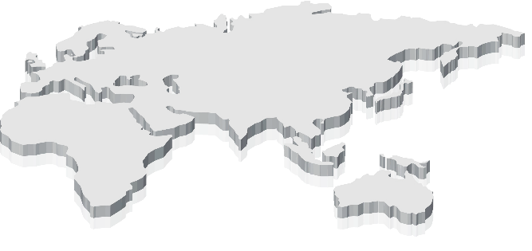



Company History
A Global Top 10 Viral Immunotherapy Pioneer
ViroCure HQ & Affiliated Research Institutes
Seoul, South Korea
North American R&D Center, Canada
University of Ottawa
ViroCure Australia
Brisbane
1999-2015 R&D Infrastructure Establishment
2016-2020 Startup and Growth
2021+ Commercialization Leap
1999
Foundational research on oncolytic virology at University of Calgary
Jun 2016
Established ViroCure Inc.
2021
RC402-IT Australia Phase 1 clinical trial (1a/1b) in progress
Feb 2017
Est. Bio Safety Level 2 (BSL2) laboratory
2002
Reovirus papers and patents
Sep 2017
Opened ViroCure USA lab @ Moffit Cancer Center in Tampa, Florida
2022
RC402-PO, MC509-N1 Preclinical
RC402-IT Clinical trial completion
2007
Myxoma virus research, papers, & patent @ University of Florida
Dec 2017
Strategic co-op w/ Seoul Asan Hospital
2023
MC509-N2/N3, RP116-M Preclinical
RC402-PO, MC509-N1
Technology transfer/Joint clinical trials
2010
Squirrel virus research, papers, & patents @ KRIBB
Apr 2019
Investment & strategic partnership w/ EDGC
Oct 2019
Est. ViroCure Australia in Brisbane
2013
Established Cancer Virus Research Center @ Dankook University College of Medicine for oncolytic virus research
Dec 2019
RC402 Clinical sample production
Jul 2020
Strategic R&D co-op w/ CHA Bundang Medical Center
Strategic partnership w/ Y Biologics

